Slide 1



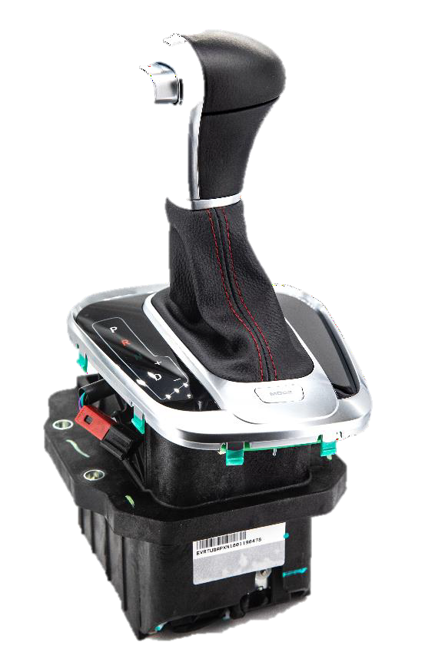

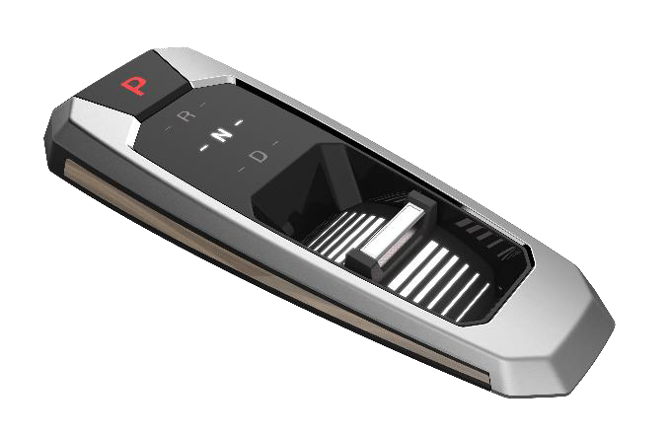
Rif. Convenzione Prot. 1059/2025 del 27/02/2025
Silatech Operations – GLOBAL EVALUATION OF CYCLE TIMES

